Slide 1

Introduction to Java

Slide 2
Java
Is a high-level, object-oriented language, similar to C++ but simplified to eliminate features that cause programming errors.
The Java source codes (.java) are compiled into a format called bytecodes (.class), which can be executed by the Java interpreter.

Slide 3
Brief history of Java
Originally called the Oak
Developed by Sun Microsystem’s engineer James Gosling
Created because James was unhappy with the results he was getting with C++
Officially launched in 1995

Slide 4
Features of Java
Simple
- It has the same results as C++ while removing the unnecessary complexities of C++.
Object-oriented
- Everything in Java is an object, a combination of different data and behaviors.
Platform Independent
- Java is a write once, run anywhere language. It can run on multiple operating systems.

Slide 5
Features of Java
Secured
- Java run inside a virtual machine sandbox securing your programs.
Architecture-neutral
- The memory is fixed to 4 bytes in either 32-bit or 64-bit systems.
Portable
- You can run your Java program to any JRE and JDK supported devices.

Slide 6
Features of Java
High-performance
- Java bytecode is close to the machine code than other languages. Though it’s a bit slower in terms of compiling, because Java is an interpreted language.
Multi-threaded
- Java can deal with many tasks at once by defining multiple threads. It shares a common memory area. Good for multimedia, and web applications.

Slide 7
Features of Java
Dynamic and Robust
- Having its automatic garbage collection and has a strong type checking mechanism against bugs/errors.
Distributed
- Access of files by calling methods from any machine.

Slide 8
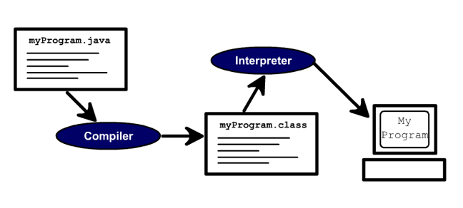
Compiler and Interpreter

